Slide 1
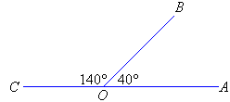
Vocabulary Word: Supplementary Angles
Q
Definition: Two angles whose
sum is 180°.

Slide 2
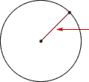
H
Vocabulary Word: Radius
Definition: A line segment with one endpoint at the center of a circle and the other endpoint on the circle.

Slide 3
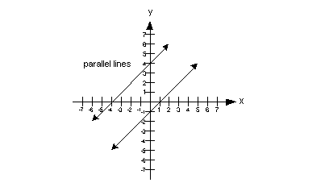
P
Vocabulary Word:
Parallel Lines
Definition: Two lines that never intersect and have the same slope.

Slide 4
Vocabulary Word: Line
C
OR
Definition: A straight path in a plane that goes on forever in opposite directions.

Slide 5
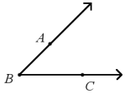
Vocabulary Word: Acute Angle
N
∠ABC or ∠CBA or ∠B
Definition: An angle that has a measure greater than 0° and less than 90°.

Slide 6
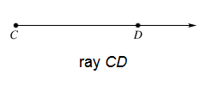
Vocabulary Word: Ray
W
Definition: A part of a line, with one endpoint, that continues without end in one direction.

Slide 7
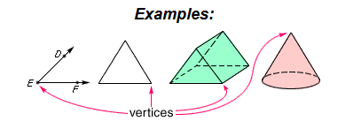
Vocabulary Word: Vertex (Plural: Vertices)
R
Definition: The point where two or more rays meet; the point of intersection of two sides of a polygon; the point of intersection of three or more edges of a solid figure; the top point of a cone.

Slide 8
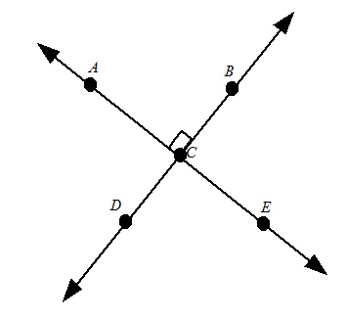
Vocabulary Word: Perpendicular Lines
L
Definition: Two lines that intersect to form right angles.

Slide 9
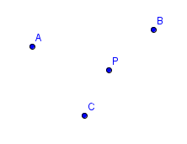
Vocabulary Word: Point
E
A, B, C, P
Definition: A precise location or place on a plane, having no size and no width.

Slide 10
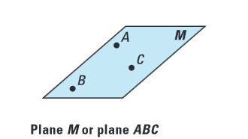
Vocabulary Word: Plane
V
Definition: A flat, two-dimensional surface.

Slide 11
Vocabulary Word: Line Segment (or Segment)
X
Definition: Two endpoints A and B and all of the points lying on the line between them.

Slide 12
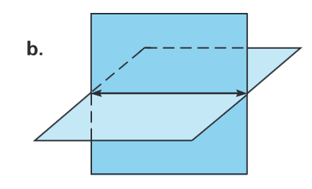
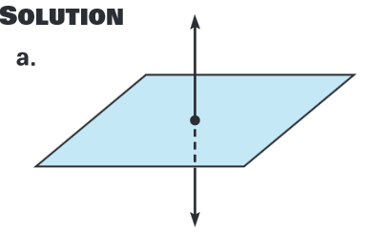
Vocabulary Word: Intersect
A
Definition: Two or more geometric figures if they have one or more points in common.

Slide 13
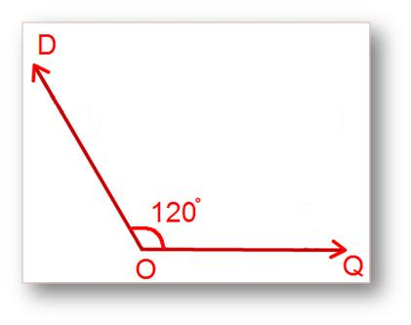
Vocabulary Word: Obtuse Angle
F
Definition: An angle with the measure greater than 90° but less than 180°.

Slide 14
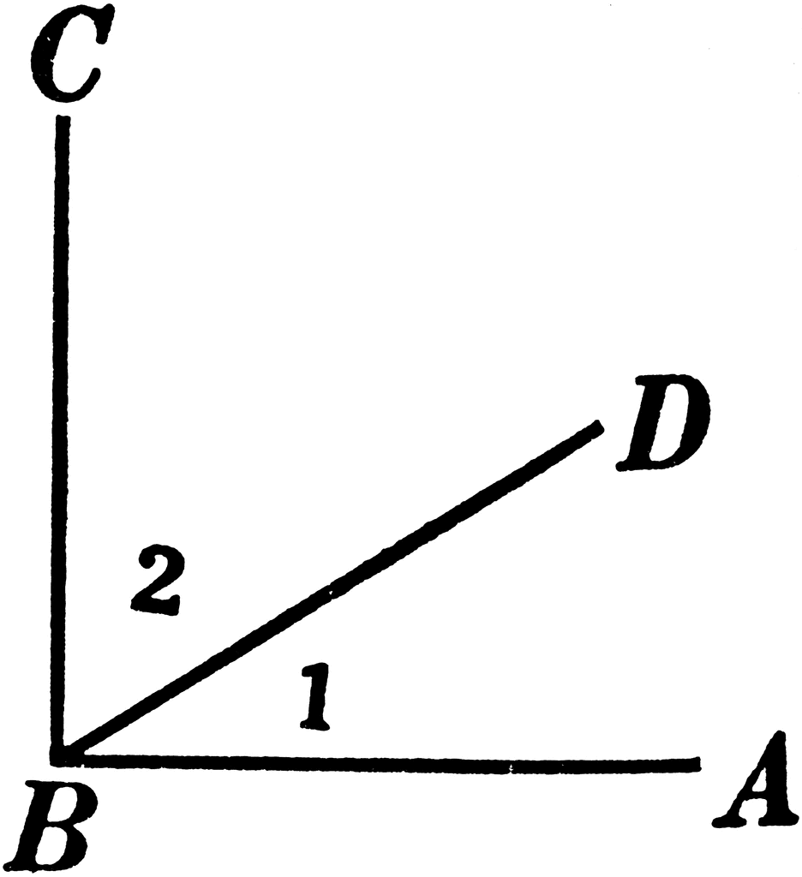
Vocabulary Word: Complementary Angles
S
Definition: Two angles
whose sum is 90°.

Slide 15
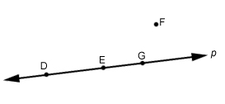
Vocabulary Word: Collinear
Z
D,E, and G are collinear on line p, but F is not.
Definition: Points that lie on the same line.

Slide 16
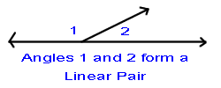
Vocabulary Word: Linear Pair
M
Definition: Two angles that sum to 180° AND are directly next to each other.

Slide 17
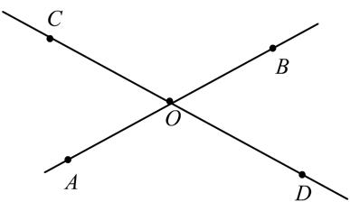
Vocabulary Word: Vertical Angles
K
Definition: Each of the pairs of opposite angles created by two intersecting lines.

Slide 18
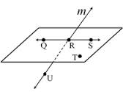
Vocabulary Word: Coplanar
Y
Definition: Points or lines that lie on the same plane.

Slide 19
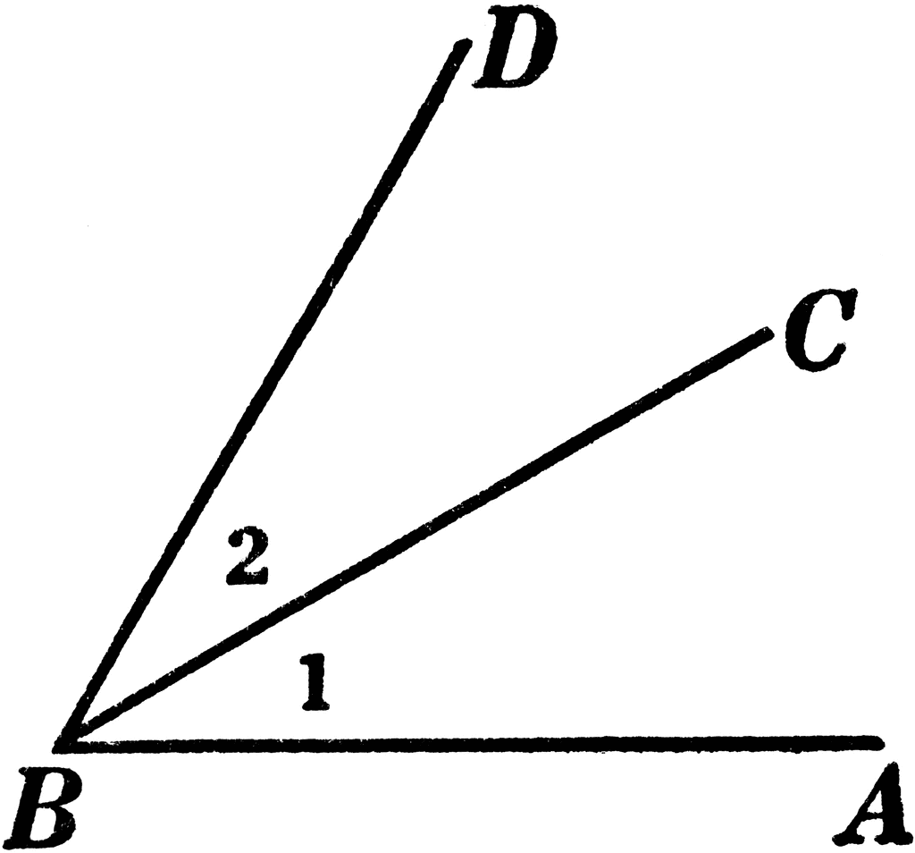
Vocabulary Word: Adjacent Angles
D
Definition: Two angles that share a common side and a common vertex.

Slide 20
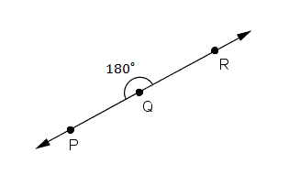
Vocabulary Word: Straight Angle
O
Definition: An angle measuring exactly 180°.

